Slide 1
Goods and Services Tax

Slide 2
1. Constitutional Framework before GST
Before GST (i.e., before July 1, 2017), India had a complex system of indirect taxes levied by both the Union and the State Governments, often leading to “tax on tax”.
Taxation Powers under the Constitution (Before GST)
Union Government (Centre) – had powers to levy taxes on:
Excise duty on manufacture of goods (Central Excise)
Customs duty on imports & exports
Service tax on provision of services
State Governments – had powers to levy taxes on:
Sale of goods (State VAT/Sales Tax)
Entry tax, Octroi
Purchase tax
Luxury tax, Entertainment tax
Constitutional Basis:
Article 246: Defined division of powers between Centre and States.
List I (Union List) – Central powers.
List II (State List) – State powers.
List III (Concurrent List) – Shared powers.

Slide 3
2. Concept of VAT (Value Added Tax)
Meaning: Value Added Tax is a tax levied at each stage of value addition in the production and distribution chain.
Example: If a manufacturer sells goods for ₹100 + VAT 10% = ₹110. Wholesaler sells for ₹150 + VAT 10% = ₹165, but he pays only tax on value added (₹50) = ₹5 to the government (after adjusting input credit ₹10 paid to manufacturer).
Tax on value added at each stage of production/distribution.
Variants: Gross Product, Income, Consumption (India uses Consumption variant).
Methods: Addition, Invoice Credit (used in India), Subtraction.

Slide 4
3. Defects in Indirect Taxes before GST
Multiplicity of Taxes – Excise, VAT, Service Tax etc.
Cascading Effect – 'Tax on Tax'.
Fragmented System between Centre & States.
Complex Compliance, Narrow Tax Base.

Slide 5
Major Defects in the Structure of Indirect Taxes prior to GST
Sr. No. | Defect | Explanation
1 | Multiplicity of Taxes | Many overlapping taxes (excise, VAT, service tax, octroi).
2 | Cascading Effect | “Tax on Tax” due to lack of input credit across goods & services.
3 | Fragmented System | Separate taxation by Centre and States without coordination.
4 | Narrow Tax Base | Many exemptions reduced revenue potential.
5 | Complex Compliance | Multiple returns and authorities created high compliance cost.
6 | Barriers to Free Trade | CST and entry tax hindered free movement of goods across states.

Slide 6
4. Rationale for GST
To eliminate cascading effect and make goods/services cheaper.
To create a unified national market (“One Nation, One Tax”).
To simplify tax structure and compliance.
To widen tax base and improve revenue efficiency.
To ensure seamless input tax credit across goods and services.
To enhance transparency and digital governance.

Slide 7
5. Structure of GST
Component | Levied by | Applicable on | Example
CGST (Central GST) | Central Govt | Intra-State supply | Within Maharashtra
SGST (State GST) | State Govt | Intra-State supply | Within Maharashtra
UTGST (Union Territory GST) | UT Govt | Intra-UT supply | Within Delhi, Chandigarh
IGST (Integrated GST) | Central Govt (shared later) | Inter-State supply | Maharashtra → Gujarat

Slide 8
6. GST Council
Constitutional Body under Article 279A.
Chairperson: Union Finance Minister.
Members: Finance Ministers of States.
Functions:
Recommend tax rates, exemptions, threshold limits.
Suggest model GST laws.
Advise on revenue sharing between Centre and States.

Slide 9
7. GST Network (GSTN)
IT Backbone of GST system.
Handles registration, returns, payments, refunds.
Section 8 non-profit company jointly owned by Centre & States.

Slide 10
8. State Compensation Mechanism
To compensate States for revenue loss due to GST.
Compensation Cess levied on luxury/sin goods (e.g., tobacco, coal, aerated drinks, cars).
States assured 14% annual revenue growth for initial 5 years (till June 2022).

Slide 11
9. Registration under GST
Who must register?
Businesses with aggregate turnover exceeding ₹40 lakh (₹20 lakh for services; lower for special category states).
Persons making inter-state supply of taxable goods.
Casual / Non-resident taxable persons.
E-commerce operators and TDS deductors.
Documents required:
PAN, Aadhaar, Address proof, Bank details, Business constitution documents.
Result:
A unique GSTIN (15-digit) is allotted for each registered entity.

Slide 12
10. GST Framework Overview (Infographic Summary)
GST Council → GST Structure (CGST, SGST, IGST) → GSTN (Digital System) → State Compensation Fund.

Slide 13
Value Added Tax(VAT)
Value Added Tax, or otherwise called as VAT, is a multi-point tax system, wherein the tax is levied by the state government, at each level of production/distribution of goods.
In this regime, the tax is levied on the incremental value of the goods, to eliminate the cascading effect, at different levels of sale. It is a type of consumption tax, wherein the value addition made by the firm is equal to the difference between proceeds and the cost of purchases.

Slide 14
Value Added Tax(VAT)
It allows the purchaser of the goods to avail input tax credit, i.e. the tax paid at the previous stage will be deducted from the net tax liability. To avail the input tax credit under VAT system, every dealer is required to obtain registration.
In this system, the VAT is levied at different types of rates, 0% is for agricultural goods and items of social importance, 1% gold and silver jewellery, 4% raw material or inputs used in manufacturing and capital goods, 20% for luxury items and remaining items are taxed as per normal slab rate, i.e. 12.5%.

Slide 15
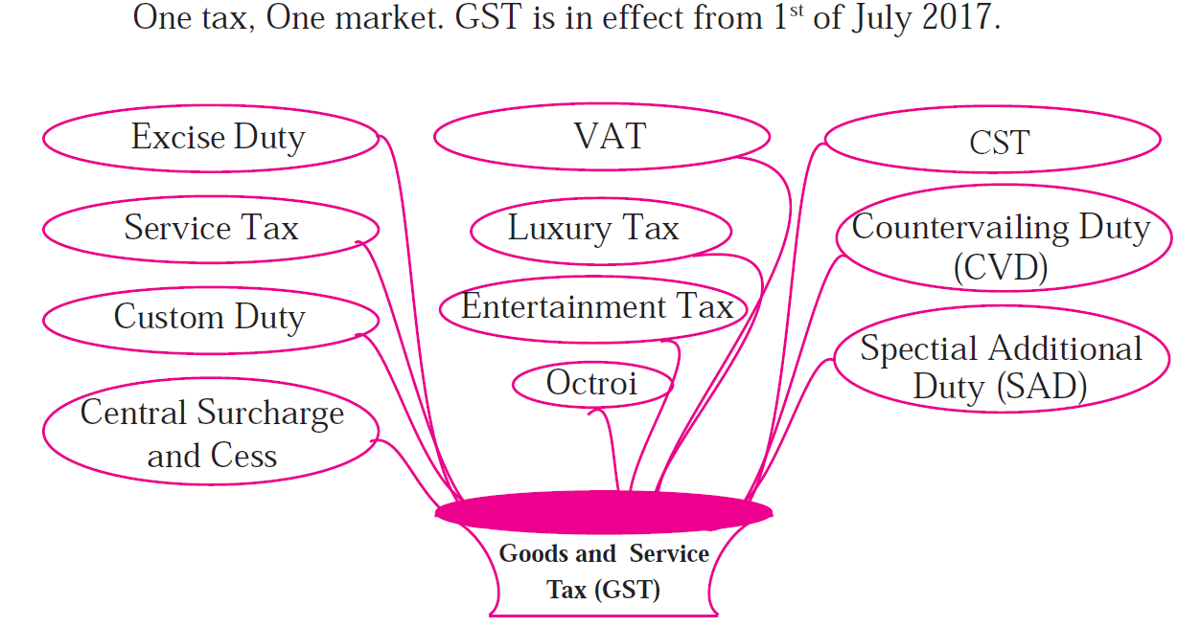
Good Service Tax(GST)

Slide 16
Good Service Test(GST)
GST stands for Goods and Services Tax, which is a destination based value added tax charged on the production, sale and consumption of goods and services. It is important to note that GST applies to the value addition at each stage, and no other tax would be levied, which results in the elimination of cascading effect.
In this system, the supplier of the goods or services is eligible to avail input tax credit, i.e. the GST paid on the purchase of goods, will be set off against the GST payable on the supply of goods and services. So, ultimately, the end consumer, bears the tax imposed by the last supplier in the distribution chain

Slide 17
Good Service Test(GST)
GST stands for Goods and Services Tax, which is a destination based value added tax charged on the production, sale and consumption of goods and services. It is important to note that GST applies to the value addition at each stage, and no other tax would be levied, which results in the elimination of cascading effect.
In this system, the supplier of the goods or services is eligible to avail input tax credit, i.e. the GST paid on the purchase of goods, will be set off against the GST payable on the supply of goods and services. So, ultimately, the end consumer, bears the tax imposed by the last supplier in the distribution chain

Slide 18
Good Service Test(GST)
In India, Dual GST has been implemented, which is simultaneously levied by the Central and State government to tax goods and services. The Centre charges the tax on intrastate sales, called as CGST.
States charges tax on the services, called SGST and UTGST in case of Union Territories.
For the interstate supply of goods and services that are taxable, are covered under IGST, i.e. Integrated Goods and Services Tax.
There are many indirect taxes, which are subsumed after the introduction of GST in India, which are as under:
At CGST level: Excise Duty, Service tax, surcharge and cess
At SGST level: Octroi or Entry tax, VAT, luxury tax, surcharge and cess
At IGST level: Central Sales Tax
GST slabs are fixed at 5%, 12%, 18% and 28%.

Slide 19
Good Service Test(GST)
Impact of GST on Consumers
Simpler Tax system
Reduction in prices of goods & services due to elimination of repeated taxes
Uniform prices throughout the country
Transparency in taxation system
Increase in employment opportunities

Slide 20
Good Service Test(GST)
Impact of GST on Traders
Reduction in multiplicity of taxes
Reducing double taxation through input tax credit
More efficient neutralisation of taxes especially for exports
Development of common national market
Simpler tax rules
Fewer rates and exemptions
Distinction between Goods & Services no longer required

Slide 21
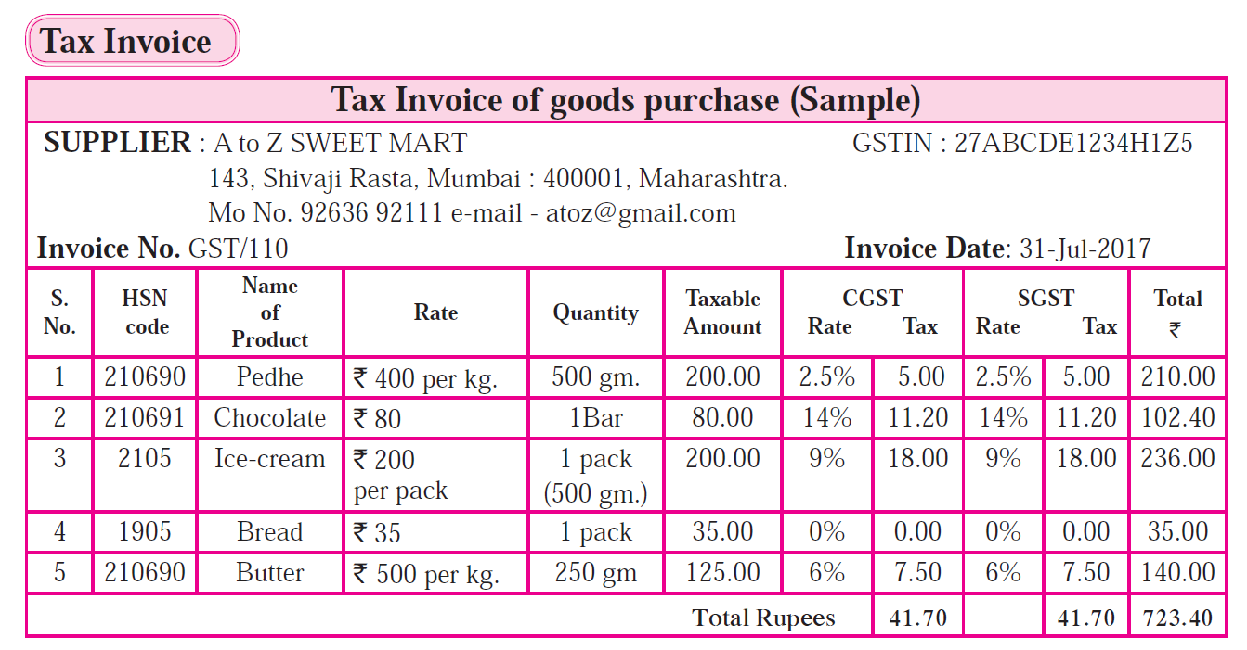
Good Service Tax(GST)

Slide 22
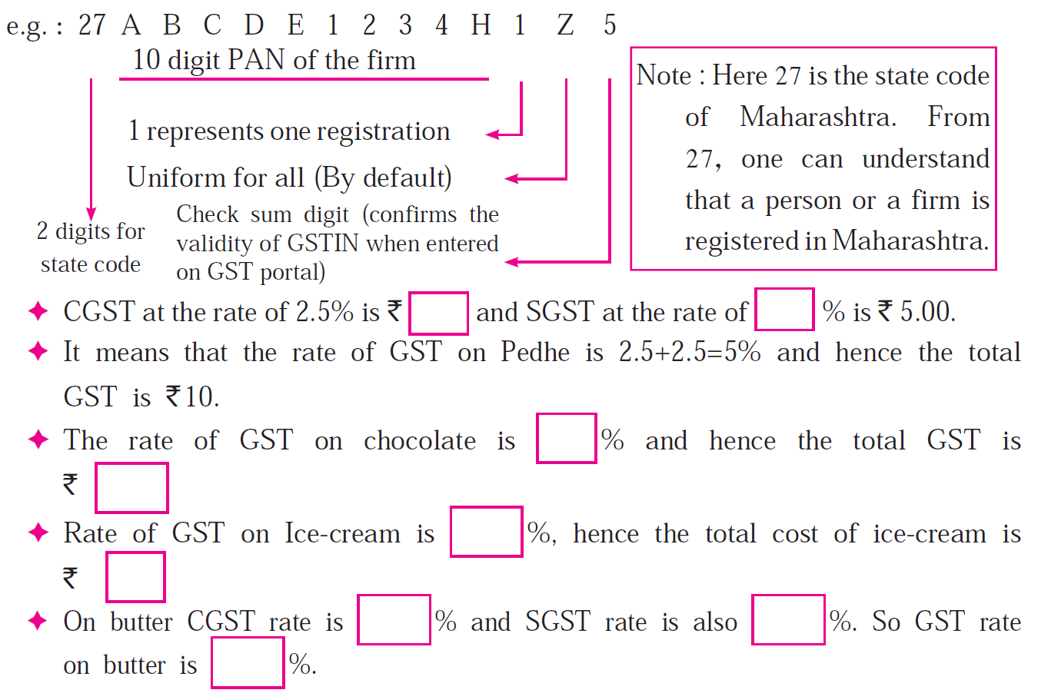
Good Service Tax(GST)

Slide 23
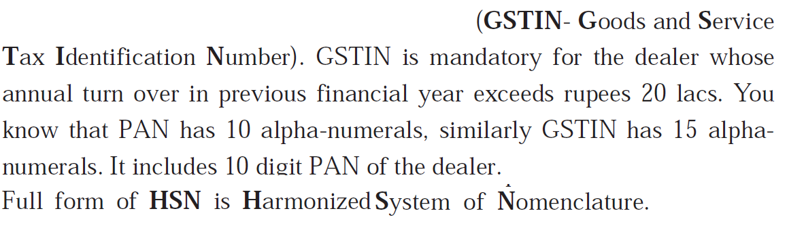
Good Service Tax(GST)

Slide 24
Good Service Tax(GST)

Slide 25
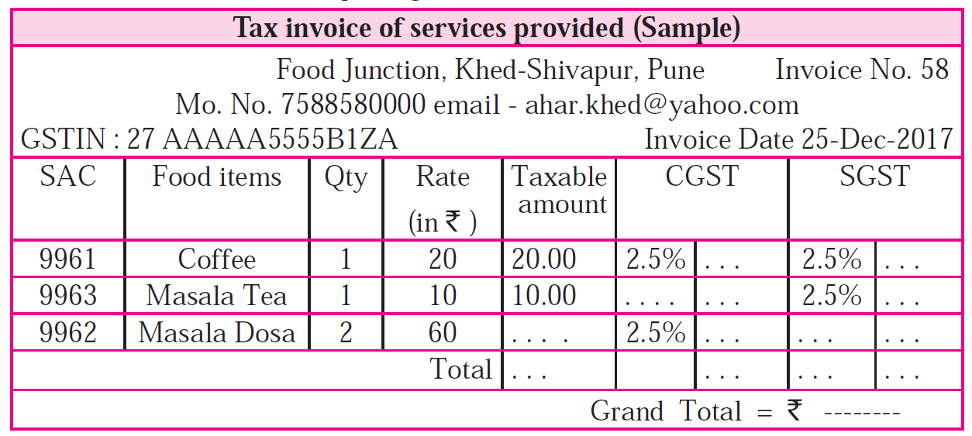
Good Service Tax(GST)

Slide 26
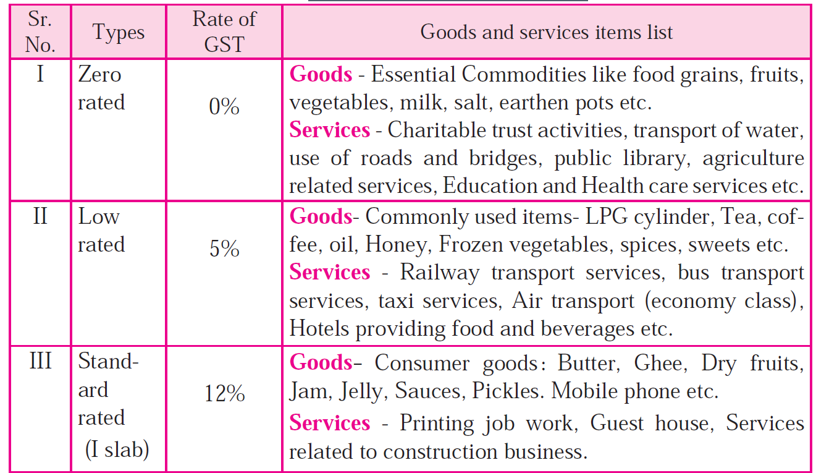
GST Slab

Slide 27
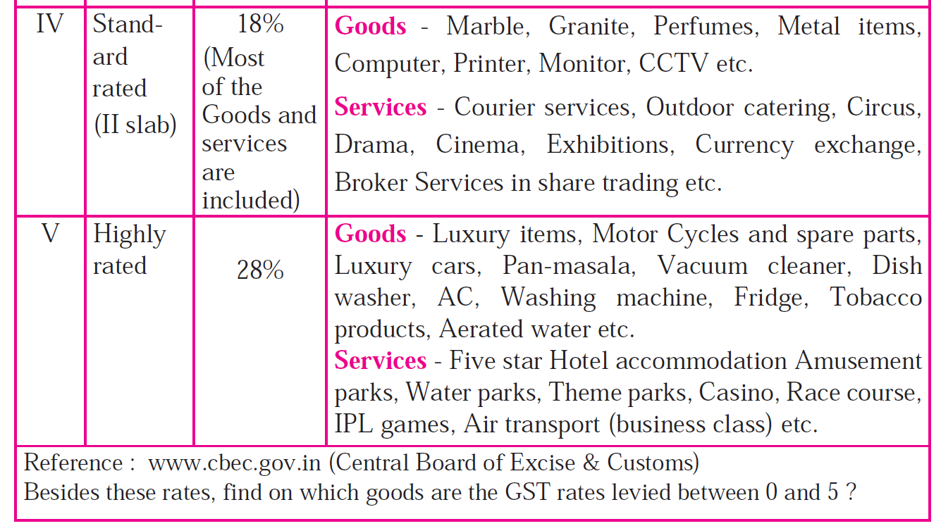
GST Slab

Slide 28
GST Slab Comparison: Old vs New (2025)
GST Slab Type | Old GST Rate | New GST Rate (2025) | Description
Exempt / NIL | 0% | 0% | Essential unbranded items, lifesaving drugs, basic education & healthcare
Merit Rate | 5% | 5% | Packaged essentials, agriculture goods, dairy, basic services
Mid-tier Rate | 12% | Merged into 5% or 18% | Previously applied to processed foods, stationery, textiles
Standard Rate | 18% | 18% | Most goods & services including electronics, professional services
Luxury/Sin Rate | 28% + cess | 40% | Tobacco, pan masala, aerated drinks, luxury cars, casinos

Slide 29
Examples of Items Under Each Slab
Item Category | Old Rate | New Rate | Remarks
Fresh milk, fruits, vegetables | 0% | 0% | No change
Packaged paneer, butter, ghee | 12–18% | 5% | Reduced
Shampoo, toothpaste, soaps | 18% | 5% | Reduced
Air conditioners, TVs | 28% | 18% | Reduced
Small cars, motorcycles ≤350cc | 28% | 18% | Reduced
Life & health insurance | 18% | 0% | Exempted
Tobacco, pan masala | 28% + cess | 40% | Increased

Slide 30
VAT v/s GST
BASIS FOR COMPARISON | VAT | GST
Meaning | VAT is a consumption tax, that is levied on the value addition, at each stage of production/distribution of goods. | GST is a destination based tax, charged on the manufacture, sale and consumption of goods and services.
Point of taxation | Sale of goods | Supply of goods and services
Payment Mode | Offline | Online
Registration | Compulsory if turnover is greater than 10 lakhs. | Compulsory if turnover is greater than 20 lakhs.
Basis of taxation | Summary based | Transaction based
Revenue Collection | Seller state collects revenue | Consumer state collects revenue
Excise Duty | It is levied, on the manufacture of excisable goods. | It is not levied.
Interstate sales | Input credit is not possible in case of interstate sales. | Input credit can be availed in case of interstate sales.
Notes:
excise duty is a tax levied on domestically produced goods

Slide 31
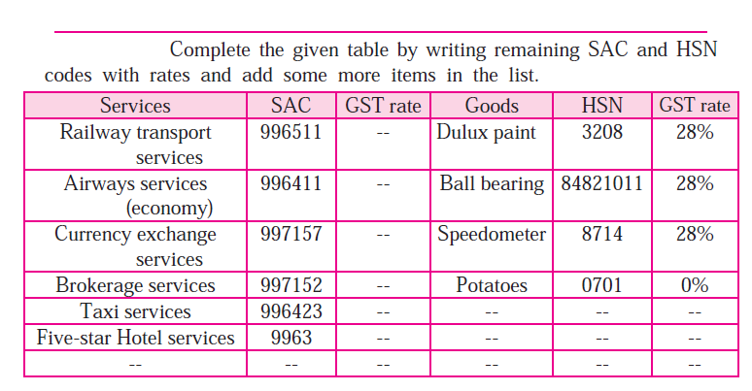
Good Service Tax(GST)
Notes:
The SAC is a six-digit code used to identify and classify services under GST. Full form: Services Accounting Code. Purpose: To determine the correct GST rate for services provided within India.
The HSN code is an internationally standardized system for classifying goods. Full form: Harmonized System of Nomenclature. Purpose: To systematically classify goods for taxation, customs, and international trade.

Slide 32
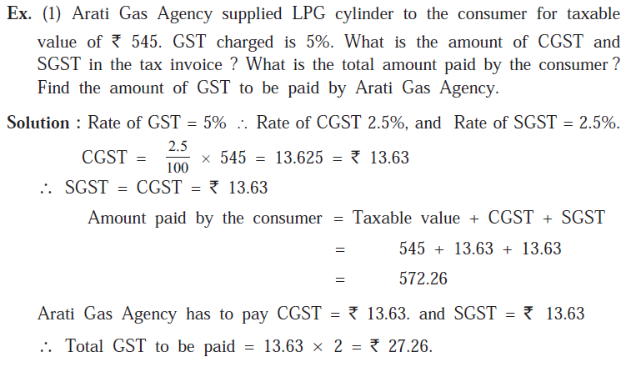
Good Service Tax(GST)

Slide 33
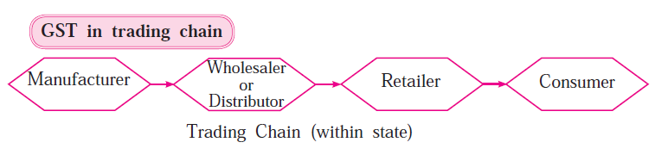
Good Service Tax(GST)

Slide 34
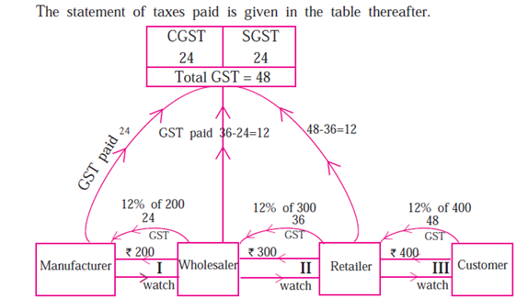
Good Service Test(GST)
Suppose manufacturer of a watch has sold one watch for `200. (including profit) to the wholsaler. Wholesaler sold that watch for`300 to the retailer. Retailer sold it to the customer for ` 400. Rate of GST charged at every stage is 12%. Then how each trader pays GST and takes his input tax credit (ITC) at every stage of transaction is shown in the following flow-chart. Observe and study it.

Slide 35
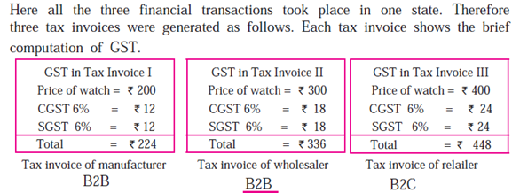
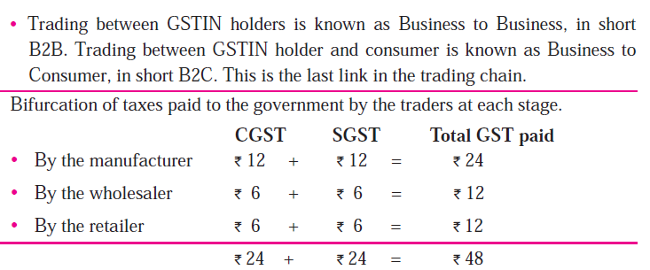
Good Service Test(GST)

Slide 36
Good Service Test(GST)
What is Input Tax Credit ? (ITC)
GST is levied and collected at every stage of trading from manufacturer to consumer. When trader pays GST at the time of purchase, it is called 'Input tax' and he collects GST at the time of sale which is called 'Output tax'. At the time of paying GST to the government a trader deducts the input tax from the output tax and pays the remaining tax. This deduction of input tax is called Input Tax Credit.
GST payable = Output tax - ITC
In short, while paying taxes to the government each trader in the trading chain subtracts the tax paid at the time of purchase from the tax collected at the time of sale and pays the remaining tax.

Slide 37
Good Service Test(GST)
Who is covered by GST?
All the businesses except agriculture and having aggregate turnover above Rs. 20 lakh in a financial year are liable to pay GST. For NRI doing business in India, it is mandatory to register under GST irrespective of the turnover of his business.
Who is exempted by GST?
Essential commodities like food grain, fruits, vegetables, milk, salt etc. and services like charitable trust activities, transport of water, agriculture related services, education and health care services etc.

Slide 38
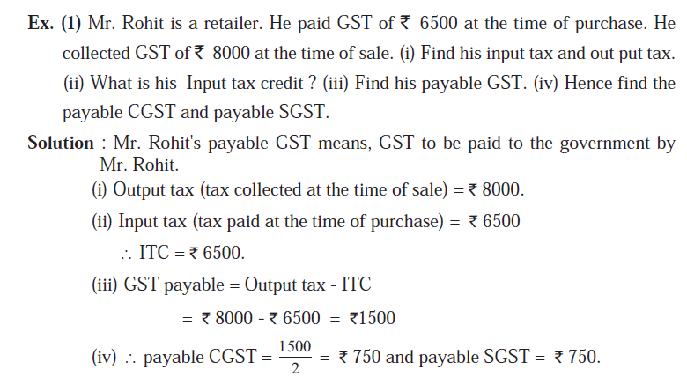
Good Service Test(GST)

Slide 39
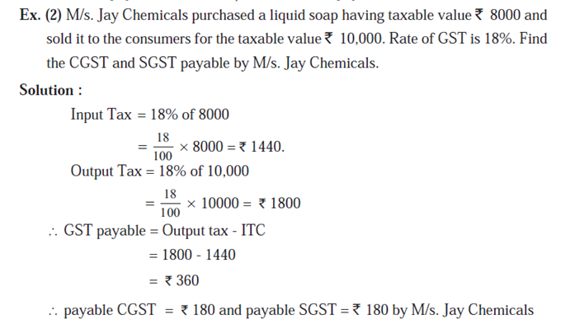
Good Service Test(GST)

Slide 40
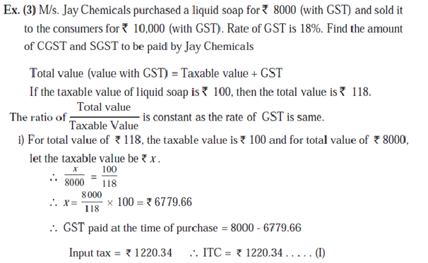
Good Service Test(GST)

Slide 41
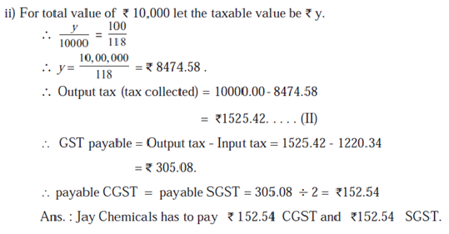
Good Service Test(GST)

Slide 42
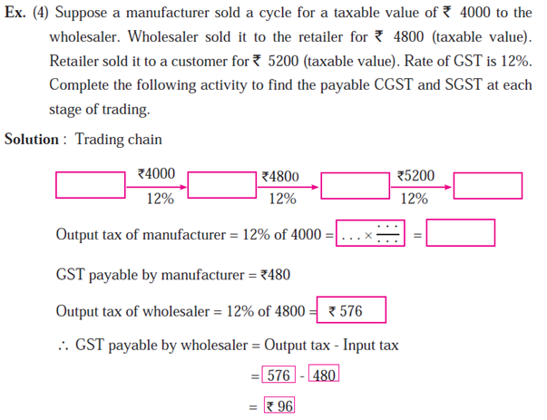
Good Service Test(GST)

Slide 43
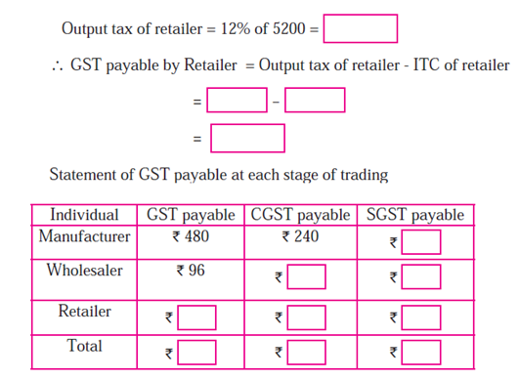
Good Service Test(GST)

Slide 44
State Compensation Mechanism in GST
State Compensation Mechanism was created to ensure that states did not lose revenue when India transitioned to the Goods and Services Tax (GST) system on 1 July 2017.
Before GST, states earned significant revenue from state-level taxes such as VAT, entry tax, luxury tax, etc. After GST, many of these taxes were subsumed into a single tax collected jointly by the Centre and the states.
To convince states to adopt GST, the Central Government guaranteed that states’ revenues would not fall below a certain level for five years (from 2017–18 to 2021–22).
The central government is obligated to compensate the states for any revenue loss incurred due to the introduction of GST for a period of five years from the date of its implementation.

Slide 45
Key features of State Compensation Mechanism
Source of Compensation, Cess: The GST compensation collected by the central government is done through the GST compensation cess, which is levied on certain luxury and demerit goods, such as cigarettes, aerated drinks, and SUVs.
Revenue Protection Formula: States were assured a 14% annual growth in their revenue based on the base year 2015–16.
projected revenue for any year =Base Year Revenue × (1 + 14%)ⁿ
where n = number of years since 2015–16.

Slide 46
Key features of State Compensation Mechanism
Compensation Amount: If a state’s actual GST revenue (SGST + IGST settlement) is less than the projected revenue, the difference is compensated by the Centre.
Compensation = Projected Revenue – Actual Revenue Example, Base Year Revenue (2015–16): ₹10,000 crore
Projected Revenue (for 2019–20):= 10,000 × (1.14)⁴ = ₹16,900 crore
Actual GST Revenue: ₹15,000 crore
Compensation Payable = ₹16,900 – ₹15,000 = ₹1,900 crore
Duration: 5 years (2017–22)
compensation period ended on 30 June 2022. After this, states no longer receive compensation payments from the Centre for any shortfall in GST revenue growth.

Slide 47
What Happens After the Compensation Period
No More Compensation for Shortfalls: States will now have to manage on their own GST revenue, without central aid for shortfalls.
Centre Still Collects GST Compensation Cess (till March 2026) The cess continues, not to pay states, but to repay borrowings the centre took during 2020–21 and 2021–22 (COVID years) to meet earlier compensation shortfalls.
Explore Additional Sources of Revenue: States can levy excise/VAT on items still outside GST e.g. petroleum, alcohol, electricity. Increase property tax, stamp duty, or vehicle tax.

Slide 48
Levy and Collection of GST
In India, the levy and collection of Goods and Services Tax (GST) are based on the supply of goods and services.
"Levy" refers to the imposition of a tax by a government authority, while "collection" is the process of gathering the tax from businesses and taxpayers.
The final tax is borne by the end consumer, making GST a consumption-based tax.
Key provisions for levy and collection
Taxable event: The taxable event under GST is the "supply" of goods and services for consideration.
Basis of levy: The tax is levied on the "transaction value," which is the price actually paid or payable for the supply.
Exemptions: The government has the power to exempt certain goods and services from GST to serve the public interest.
Composition scheme: Small taxpayers can opt for a composition scheme, which allows them to pay tax at a lower, fixed rate on their turnover, simplifying compliance.
Online process: The entire process of GST compliance, including registration, return filing, and payments, is managed online through the Goods and Services Tax Network (GSTN) portal, which increases efficiency and transparency.

Slide 49
Dual GST Model
India uses a dual GST system, where both the central government and state governments levy and collect the tax. This structure ensures that both tiers of government have a share of the revenue. The type of GST applied depends on the location of the supplier and the consumer.
Intra-state supply (within one state or Union Territory)
For transactions within the same state or Union Territory, two components of GST are levied simultaneously:
Central GST (CGST): The tax levied by the central government.
State GST (SGST) or Union Territory GST (UTGST): The tax levied by the respective state or Union Territory government.
For example, if the GST rate is 18%, it is split equally, with 9% going to the central government and 9% to the state government.
Inter-state supply (between different states or Union Territories)
For transactions between states or Union Territories, the central government levies and collects Integrated GST (IGST).
The IGST collected is the sum of the CGST and SGST rates.
The central government then shares the IGST revenue with the destination state, where the goods or services were consumed.

Slide 50
Time, Place and Value of Supply
Taxable event: Taxable event is very important matter in every tax law. Its determination is most crucial for the proper implementation of any tax law. Taxable event is that on the happening of which the charge is fixed. It is that event which on its occurrence creates or attracts the liability to tax. Sales, purchase, removal of goods, services, luxury, entertainment and so on, the list goes on.
Taxable event under GST: One of the very important feature of the regime of GST is the complete change in the taxable event different altogether from the taxable events witnessed in the indirect taxes as yet. The taxable event in the GST would be supply of goods and/or services. As per Article 366(1A) of Constitution of India Goods and Services Tax means a tax on supply of goods or services or both except taxes on supply of alcoholic liquor for human consumption.

Slide 51
Time, Place and Value of Supply
Time of supply means the point in time when goods/services are considered supplied’. When the seller knows the ‘time’, it helps him identify due date for payment of taxes.
Place of supply is required for determining the right tax to be charged on the invoice, whether IGST or CGST/SGST will apply.
Value of supply is important because GST is calculated on the value of the sale. If the value is calculated incorrectly, then the amount of GST charged is also incorrect

Slide 52
Time of Supply of Goods
Time of supply of goods is earliest of:
1. Date of issue of invoice
2. Last date on which invoice should have been issued
3. Date of receipt of advance/ payment.
For example:
Mr. X sold goods to Mr. Y worth Rs 1,00,000. The invoice was issued on 15th January. The payment was received on 31st January. The goods were supplied on 20th January.

Slide 53
Time of Supply of Goods
Let us analyze and arrive at the time of supply in this case.
Time of supply is earliest of –
Date of issue of invoice – 15th January
Last date on which invoice should have been issued – 20th January.
Thus the time of supply is 15th January.
What will happen if, in the same example an advance of Rs 50,000 is received by Mr. X on 1st January?
The time of supply for the advance of Rs 50,000 will be 1st January(since the date of receipt of advance is before the invoice is issued). For the balance Rs 50,000, the time of supply will be 15th January.

Slide 54
Time of Supply for Services
Time of supply of services is earliest of:
Date of issue of invoice
Date of receipt of advance/ payment.
Date of provision of services (if invoice is not issued within prescribed period)
Let us understand this using an example:
Mr. A provides services worth Rs 20000 to Mr. B on 1st January. The invoice was issued on 20th January and the payment for the same was received on 1st February.

Slide 55
Time of Supply for Services
In the present case, we need to 1st check if the invoice was issued within the prescribed time. The prescribed time is 30 days from the date of supply i.e. 31st January. The invoice was issued on 20th January. This means that the invoice was issued within a prescribed time limit.
The time of supply will be earliest of –
Date of issue of invoice – 20th January
Date of payment = 1st February
This means that the time of supply of services will be 20th January.

Slide 56
Time of Supply under Reverse Charge
Under Reverse Charge Mechanism (RCM), the recipient of goods or services (not the supplier) is liable to pay GST directly to the government.
Time of Supply – Key Rule
The time of supply determines when GST liability arises.
For Reverse Charge – Services:
The time of supply for services is the earliest of the following:
Date of payment, or
60 days from the date of issue of invoice by the supplier.
For example:
M/s ABC Pvt. Ltd undertook service of a director Mr. X worth Rs. 50,000 on 15th January. The invoice was raised on 1st February. M/s ABC Pvt Ltd made the payment on 1st May.
Step 1: Identify the two possible dates
Date of payment: 1 May
60 days from invoice date: 1 February + 60 days = 2 April
Step 2: Choose the earlier date
Earliest of (1 May, 2 April) = 2 April
Therefore, the Time of Supply = 2 April.

Slide 57
Time of Supply Summary
Time of Supply (RCM – Services) =
Earlier of (Date of Payment, 60 days from Invoice Date)
Time of Supply (RCM – Goods) =
Earlier of (Date of Payment, 30 days from Invoice Date)
Aspect | Goods | Services
Invoice time limit | At time of removal/supply | Within 30 days of supply
GST on advance | Not applicable | Applicable
Time of supply rule | Earlier of invoice/supply/payment | Earlier of invoice/payment/service

Slide 58
Place of Supply
It is very important to understand the term ‘place of supply’ for determining the right tax to be charged on the invoice.
Here is an example:
Location of Service Receiver | Place of supply | Nature of Supply | GST Applicable
Maharashtra | Maharashtra | Intra-state | CGST + SGST
Maharashtra | Kerala | Inter-state | IGST

Slide 59
Place of Supply
It is very important to understand the term ‘place of supply’ for determining the right tax to be charged on the invoice.
Here is an example:
Location of Service Receiver | Place of supply | Nature of Supply | GST Applicable
Maharashtra | Maharashtra | Intra-state | CGST + SGST
Maharashtra | Kerala | Inter-state | IGST

Slide 60
Place of Supply of Goods
Usually, in case of goods, the place of supply is where the goods are delivered.
So, the place of supply of goods is the place where the ownership of goods changes.
If there is no movement of goods then the place of supply is the location of goods at the time of delivery to the recipient.
For example: In case of sales in a supermarket, the place of supply is the supermarket itself.
Place of supply in cases where goods that are assembled and installed will be the location where the installation is done.
For example, A supplier located in Kolkata supplies machinery to the recipient in Delhi. The machinery is installed in the factory of the recipient in Kanpur. In this case, the place of supply of machinery will be Kanpur.

Slide 61
Place of Supply for Services
Generally, the place of supply of services is the location of the service recipient.
In cases where the services are provided to an unregistered dealer and their location is not available the location of service provider will be the place of provision of service.
Special provisions have been made to determine the place of supply for the following services:
Services related to immovable property
Restaurant services
Admission to events
Transportation of goods and passengers
Telecom services
Banking, Financial and Insurance services.
In case of services related to immovable property, the location of the property is the place of provision of services.

Slide 62
Place of Supply for Services
Example 1:
Mr. Anil from Delhi provides interior designing services to Mr. Ajay(Mumbai). The property is located in Ooty(Tamil Nadu).
In this case, place of supply will be the location of the immovable property i.e. Ooty, Tamil Nadu.
Example 2:
A registered taxpayer offers passenger transport services from Bangalore to Hampi. The passengers do not have GST registration. What will be the place of supply in this case?
The place of supply is the place from where the departure takes place i.e. Bangalore in this case.

Slide 63
Place of Supply When There is Movement of Goods
Supply Type | Place of supply
Involves movement of goods, whether by supplier, or buyer or by any other person | Location of the goods when the movement of goods terminates for delivery to the recipient.
Goods are delivered by the seller to the buyer on the directions of a third party (whether or not an agent), before or during the movement of goods, by the way of transfer of title in goods or the documents or some other way | It is assumed that the third person has received the goods and therefore, the place of supply of the goods will be the principal place of business of the third party.

Slide 64
Place of Supply When There is Movement of Goods
Example 1- Intra-state sales Mr. Raj of Mumbai, Maharashtra sells 10 TV sets to Mr. Vijay of Nagpur, Maharashtra
The place of supply is Nagpur in Maharashtra. Since it is the same state CGST & SGST will be charged.
Example 2-Inter-State sales Mr. Raj of Mumbai, Maharashtra sells 30 TV sets to Mr. Vinod of Bangalore, Karnataka
The place of supply is Bangalore in Karnataka. Since it is a different state IGST will be charged.

Slide 65
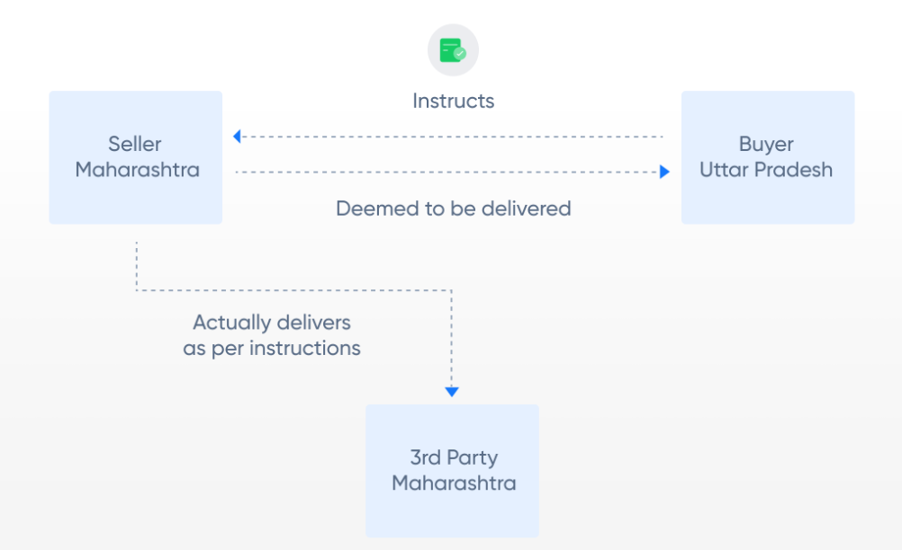
Place of Supply When There is Movement of Goods
Example 3- Deliver to a 3rd party as per instructions Anand in Lucknow buys goods from Mr. Raj in Mumbai (Maharashtra). The buyer requests the seller to send the goods to Nagpur (Maharashtra)
In this case, it will be assumed that the buyer in Lucknow has received the goods & IGST will be charged. Place of supply: Lucknow (UP) GST: IGST

Slide 66
Place of Supply – No Movement of Goods
Example 1- No movement of goods: Sales Heaven Ltd. (Chennai) opens a new showroom in Bangalore. It purchases a building for showroom from ABC Realtors (Bangalore) along with pre-installed workstations
Place of supply: Bangalore GST: CGST & SGST There is no movement of goods (work stations), so the place of supply will be the location of such goods at the time of delivery (handing over) to the receiver.
Supply Type | Place of Supply
No movement of goods, either by the supplier or by the recipient | Location of those goods at the time of delivery to the recipient (at the time of ownership transfer)
Goods are assembled or installed at site | Place of installation or assembly

Slide 67
Place of Supply – No Movement of Goods
Example 2- Installing goods: Strong Iron & Steel Ltd. (Jharkhand) asks M/s SAAS Constructions (West Bengal) to build a blast furnace in their Jharkhand steel plant
Place of supply: Jharkhand GST: CGST & SGST Although M/s SAAS is in West Bengal, the goods (blast furnace) is being installed at site in Jharkhand which will be the place of supply.
Particulars | Location of the supplier | Location of the recipient ( Registered office) | Site of the assembly /installation | Place of supply | GST
Goods are assembled or installed at site | West Bengal | Orissa | Jharkhand | Jharkhand | CGST+SGST (Jharkhand)
 | Jharkhand | Jharkhand | Jharkhand | Jharkhand | CGST+SGST (Jharkhand)
 | Jharkhand | Jharkhand | Orissa | Orissa | CGST+SGST (Orissa)
 | Jharkhand | Jharkhand | Tamil Nadu | Tamil Nadu | CGST+SGST (Tamil Nadu)
 | Jharkhand | Tamil Nadu | Jharkhand | Jharkhand | CGST+SGST (Jharkhand)

Slide 68
Place of Supply – No Movement of Goods
Example 2- Installing goods Strong Iron & Steel Ltd. (Jharkhand) asks M/s SAAS Constructions (West Bengal) to build a blast furnace in their Jharkhand steel plant
Place of supply: Jharkhand GST: CGST & SGST Although M/s SAAS is in West Bengal, the goods (blast furnace) is being installed at site in Jharkhand which will be the place of supply.
Particulars | Location of the supplier | Location of the recipient ( Registered office) | Site of the assembly /installation | Place of supply | GST
Goods are assembled or installed at site | West Bengal | Orissa | Jharkhand | Jharkhand | CGST+SGST (Jharkhand)
 | Jharkhand | Jharkhand | Jharkhand | Jharkhand | CGST+SGST (Jharkhand)
 | Jharkhand | Jharkhand | Orissa | Orissa | CGST+SGST (Orissa)
 | Jharkhand | Jharkhand | Tamil Nadu | Tamil Nadu | CGST+SGST (Tamil Nadu)
 | Jharkhand | Tamil Nadu | Jharkhand | Jharkhand | CGST+SGST (Jharkhand)

Slide 69
Place of Supply- Goods Supplied on a Vessel/Conveyance
Example 1- Plane: Mr. Ajay is travelling from Mumbai to Delhi by air. He purchases coffee and snacks while on the plane. The airline is registered in both Mumbai and Delhi.
Place of supply: Mumbai GST: CGST & SGST The food items were loaded into the plane at Mumbai. So, the place of supply becomes Mumbai.
Example 2- Plane: Business travel Mr. Ajay is travelling from Mumbai to Chennai by air on behalf of his company Ram Gopal and Sons (registered in Bangalore). In the plane he purchases lunch. The airline is registered in Mumbai & Chennai.
Place of supply: Mumbai GST: CGST & SGST The food items were loaded into the plane at Mumbai. So, the place of supply becomes Mumbai. It does not matter where the buyer is registered.
Supply Type | Place of Supply
Goods are on board of a conveyance or vessel or train or aircraft or a motor vehicle | Location at which such goods are taken on board.

Slide 70
Place of Supply – Imports and Exports
Example 1- Import
Ms. Malini imports school bags from China for her shop (registered in Mumbai)
Place of supply: Mumbai GST: IGST
Example 2- Export
Ms. Anita (Kolkata) exports Indian perfumes to UK
Place of supply: Kolkata GST: Exempted
The place of supply of goods:
imported into India will be the location of the importer.
exported from India shall be the location outside India.
Supply Type | Place of Supply | GST
Goods imported into India | Location of the importer | Always IGST is charged for imports
Exported from India | Location outside India | GST on exports are eligible for refund

Slide 71
Valuation Rule for Supply Under Goods and Services Tax
1.Value of supply of goods or services where the consideration is not wholly in money, the value of the supply shall, be the open market value of such supply:
if open market value is not available, be the sum total of consideration in money and any such further amount in money as is equivalent to the consideration not in money if such amount is known at the time of supply;
( if the value of supply is not determinable under clause (a) or clause (b), be the value of supply of goods or services or both of like kind and quality;
if value is not determinable under clause (a) or clause (b) or clause (c), be the sum total of consideration in money.
For Example: (i) Where a new phone is supplied for Rs. 20000 along with the exchange of an old phone and if the price of the new phone without exchange is Rs. 24000, the open market value of the new phone is Rs. 24000.
(ii) Where a laptop is supplied for Rs. 40000 along with a barter of printer that is manufactured by the recipient and the value of the printer known at the time of supply is Rs. 4000 but the open market value of the laptop is not known, the value of the supply of laptop is Rs. 44000

Slide 72
1. When consideration is not wholly in money
If a seller receives something other than money (e.g., exchange, barter, part-cash part-goods), the value of supply is determined in the following order:
(a) Open Market Value (OMV)
The first preference is to take the Open Market Value — the price that goods or services would fetch in an open market. Example: A car is exchanged for a bike + ₹1,00,000. If similar cars sell for ₹10,00,000 in the market → Value = ₹10,00,000.
(b) If OMV not available
Value = Money received + monetary equivalent of non-monetary consideration (if known at the time of supply). Example: A laptop is supplied in exchange for ₹40,000 + old desktop (worth ₹10,000). → Value = ₹50,000
(c) If still not determinable
Use the value of supply of goods/services of like kind and quality — i.e., goods or services similar in characteristics, quality, quantity, and reputation. Example: If similar laptops sell for ₹52,000 → Value = ₹52,000
(d) If none of the above works
Then, the value = total consideration in money (i.e., whatever money part is known). Example: If only ₹40,000 (cash part) is known and no other reference value is available → Value = ₹40,000

Slide 73
Valuation Rule for Supply Under Goods and Services Tax
1.Value of supply of goods or services where the consideration is not wholly in money
Where the supply of goods or services is for a consideration not wholly in money, the value of the supply shall, be the open market value of such supply;
if open market value is not available, be the sum total of consideration in money and any such further amount in money as is equivalent to the consideration not in money if such amount is known at the time of supply;
( if the value of supply is not determinable under clause (a) or clause (b), be the value of supply of goods or services or both of like kind and quality;
if value is not determinable under clause (a) or clause (b) or clause (c), be the sum total of consideration in money.
For Example: (i) Where a new phone is supplied for Rs. 20000 along with the exchange of an old phone and if the price of the new phone without exchange is Rs. 24000, the open market value of the new phone is Rs. 24000.
(ii) Where a laptop is supplied for Rs. 40000 along with a barter of printer that is manufactured by the recipient and the value of the printer known at the time of supply is Rs. 4000 but the open market value of the laptop is not known, the value of the supply of laptop is Rs. 44000

Slide 74
Valuation Rule for Supply Under Goods and Services Tax
2.Value of supply of goods or services or both between distinct or related persons, other than through an agent The value of the supply of goods or services or both between distinct persons as specified in sub-section (4) and (5) of section 25 or where the supplier and recipient are related, other than where the supply is made through an agent, shall,-
be the open market value of such supply;
if open market value is not available, be the value of supply of goods or services of like kind and quality;
if value is not determinable under clause (a) or (b), be the value as determined by application of rule 4 or rule 5, in that order:
Provided where the recipient is eligible for full input tax credit, the value declared in the invoice shall be deemed to be the open market value of goods or services.

Slide 75
Valuation Rule for Supply Under Goods and Services Tax
2.Value of supply of goods or services or both between distinct or related persons, other than through an agent The value of the supply of goods or services or both between distinct persons as specified in sub-section (4) and (5) of section 25 or where the supplier and recipient are related, other than where the supply is made through an agent, shall,-
be the open market value of such supply;
if open market value is not available, be the value of supply of goods or services of like kind and quality;
if value is not determinable under clause (a) or (b), be the value as determined by application of rule 4 or rule 5, in that order:
Provided where the recipient is eligible for full input tax credit, the value declared in the invoice shall be deemed to be the open market value of goods or services.

Slide 76
Valuation Rule for Supply Under Goods and Services Tax
3.Value of supply of goods made or received through an agent The value of supply of goods between the principal and his agent shall,- be the open market value of the goods being supplied, or at the option of the supplier, be 90% of the price charged for the supply of goods of like kind and quality by the recipient to his customer not being a related person, where the goods are intended for further supply by the said recipient;
For Example:
Where a principal supplies groundnut to his agent and the agent is supplying groundnuts of like kind and quality in subsequent supplies at a price of Rs. 5000 per quintal on the day of supply. Another independent supplier is supplying groundnuts of like kind and quality to the said agent at the price of Rs. 4550 per quintal. The value of the supply made by the principal shall be Rs. 4550 per quintal or where he exercises the option the value shall be 90% of the Rs. 5000 i.e. is Rs. 4500 per quintal.

Slide 77
Valuation Rule for Supply Under Goods and Services Tax
4.Value of supply of goods or services or both based on cost
Where the value of a supply of goods or services or both is not determinable by any of the preceding rules, the value shall be one hundred and ten percent of the cost of production or manufacture or cost of acquisition of such goods or cost of provision of such services.
5. Residual method for determination of value of supply of goods or services or both
Where the value of supply of goods or services or both cannot be determined under rules 1 to 4, the same shall be determined using reasonable means consistent with the principles and general provisions of section 15 and these rules. Provided that in case of supply of services, the supplier may opt for this rule, disregarding rule 4. This is a general residual rule, to be used as a last resort. This is again open ended and refers to principles and general provisions as per law and other rules.

Slide 78
4. Value of Supply Based on Cost (Rule 30)
When the value of supply cannot be determined using previous rules (like open market value, like kind, etc.),
It is taken as 110% of the cost of production/acquisition/provision.
Formula:𝑉𝑎𝑙𝑢𝑒=𝐶𝑜𝑠𝑡+10% of Cost
Example:A company manufactures goods at a cost of ₹50,000.There is no open market value or comparable supply.
Value of supply = ₹50,000 + 10% = ₹55,000

Slide 79
5. Residual Method (Rule 31)
If value still cannot be determined under Rules 1–4,
👉 It is determined using reasonable means consistent with GST principles.
This is a “last resort” rule — open-ended, allowing flexibility.
Example: A new customized software is developed, with no comparable price and unknown cost structure.
→ Value is determined reasonably by agreement between parties following Section 15 principles.
💡 For services, supplier may directly choose this rule instead of cost-based Rule 30.

Slide 80
Valuation Rule for Supply Under Goods and Services Tax
6.Determination of value in respect of certain supplies
The value in respect of supplies specified below shall be determined in the manner provided hereinafter. Rule-32(2) Purchase/ Sale of Foreign Currency – The value of supply of services in relation to purchase or sale of foreign currency, including money changing, shall be determined by the supplier of service in the following manner:-
(i) For a currency, when exchanged from, or to, Indian Rupees (INR), the value shall be equal to the difference in the buying rate or the selling rate, as the case may be, and the Reserve Bank of India (RBI) reference rate for that currency at that time, multiplied by the total units of currency.
(ii) At the option of supplier of services, the value in relation to supply of foreign currency, including money changing, shall be deemed to be

Slide 81
Valuation Rule for Supply Under Goods and Services Tax
1 % of the gross amount of currency exchanged for an amount up to one lakh rupees, subject to a minimum amount of two hundred and fifty rupees;
(ii) one thousand rupees(1,000) and half of a per cent (0.5%) of the gross amount of currency exchanged for an amount exceeding one lakh rupees and up to ten lakh rupees; and
(iii) five thousand rupees (5,000) and one tenth of a per cent (0.10%) of the gross amount of currency exchanged for an amount exceeding ten lakh rupees, subject to maximum amount of sixty thousand rupees.
7. Value of supply of services in case of pure agent Notwithstanding anything contained in these rules, the expenditure or costs incurred by the supplier as a pure agent of the recipient of supply of services shall be excluded from the value of supply, if all the following conditions are satisfied, namely: -
the supplier acts as a pure agent of the recipient of the supply, when he makes payment to the third party for the services procured;
the recipient of supply uses the services so procured by the supplier service provider in his capacity as pure agent of the recipient of supply;

Slide 82
Valuation Rule for Supply Under Goods and Services Tax
the recipient of supply is liable to make payment to the third party; the recipient of supply authorizes the supplier to make payment on his behalf;
the recipient of supply knows that the services for which payment has been made by the supplier shall be provided by the third party;
the payment made by the supplier on behalf of the recipient of supply has been separately indicated in the invoice issued by the supplier to the recipient of service;
the supplier recovers from the recipient of supply only such amount as has been paid by him to the third party; and
the services procured by the supplier from the third party as a pure agent of the recipient of supply are in addition to the supply he provides on his own account.

Slide 83
Valuation Rule for Supply Under Goods and Services Tax
8. Rate of exchange of currency, other than Indian rupees, for determination of value
The rate of exchange for determination of value of taxable goods or services or both shall be the applicable reference rate for that currency as determined by the Reserve Bank of India on the date when point of taxation arises.

Slide 84
6. Determination of Value for Certain Supplies (Rule 32)
Purchase/Sale of Foreign Currency (Money Changing Services)
Two Methods:
Standard Method
Value = (Difference between buying/selling rate and RBI reference rate) × (Total units of currency).
Example: Bank buys $1,000 at ₹83 per USD, RBI rate ₹83.20 →
Difference ₹0.20 × 1,000 = ₹200 → Value of service = ₹200.
(ii) Optional Slab Method (for small traders)

Slide 85
(ii) Optional Slab Method (for small traders)
Amount Exchanged | Value of Supply
Up to ₹1,00,000 | 1% of amount (min ₹250)
₹1,00,000 – ₹10,00,000 | ₹1,000 + 0.5% of excess over ₹1,00,000
Above ₹10,00,000 | ₹5,000 + 0.1% of excess (max ₹60,000)
Example:
Exchange ₹8,00,000 → ₹1,000 + 0.5% × ₹7,00,000 = ₹1,000 + ₹3,500 = ₹4,500
✅ Value of service = ₹4,500.

Slide 86
7. Value of Supply of Services in Case of a Pure Agent (Rule 33)
When a supplier pays on behalf of the recipient as a pure agent, those expenses are excluded from value of supply — if all conditions are met.
Conditions:
Supplier acts as pure agent for recipient.
Recipient is actually liable to pay that amount.
Recipient authorizes supplier to pay.
Such payment is shown separately in invoice.
Supplier recovers exactly what he paid, no markup.
Example: A CA firm files tax returns for a client and pays ₹5,000 government filing fees on client’s behalf.
It charges ₹10,000 for its own service.
Only ₹10,000 is taxable under GST;
₹5,000 (paid as pure agent) is excluded.

Slide 87
8. Rate of Exchange of Currency (Rule 34
For foreign currency transactions,
👉 the exchange rate used to determine value = RBI reference rate on the date when time of supply arises.
Example:
If goods imported on 5th May and RBI rate = ₹83.50 per USD,
→ that rate is used for GST valuation.
Rule | Basis of Value | Method / Principle | Example Value
30 | Cost-based | 110% of cost | ₹55,000
31 | Residual | Reasonable method | As per fair estimate
32 | Special Cases | e.g. Forex, ticketing, insurance | ₹4,500
33 | Pure Agent | Exclude reimbursed expenses | ₹10,000 taxable
34 | Currency Conversion | RBI rate on date of supply | ₹83.50/USD

Slide 88
GST exemption
What is a GST exemption?
Understanding the taxability of goods and services also includes knowing whether a good or service is exempted from GST registration. Upon knowing this, applicants can get clarity on several other factors. Essentially, the GST exemption limit for businesses depends on their annual aggregate turnover.
Previously, businesses with an annual turnover of up to Rs.20 lakhs did not need to register for GST. The amount was Rs.10 lakhs for North-eastern or hilly states like Meghalaya, Sikkim, Mizoram, Arunachal Pradesh, Nagaland, Himachal Pradesh, Manipur, Assam, Tripura, Uttarakhand, and Jammu & Kashmir.
However, as per the GST council meeting on 10th January 2019, the values doubled for Micro, Small, and Medium Enterprises (MSMEs) in both cases.

Slide 89
GST exemption
What is a GST exemption?
Understanding the taxability of goods and services also includes knowing whether a good or service is exempted from GST registration. Upon knowing this, applicants can get clarity on several other factors. Essentially, the GST exemption limit for businesses depends on their annual aggregate turnover.
Previously, businesses with an annual turnover of up to Rs.20 lakhs did not need to register for GST. The amount was Rs.10 lakhs for North-eastern or hilly states like Meghalaya, Sikkim, Mizoram, Arunachal Pradesh, Nagaland, Himachal Pradesh, Manipur, Assam, Tripura, Uttarakhand, and Jammu & Kashmir.
As per the GST council meeting on 10th January 2019, the values doubled for Micro, Small, and Medium Enterprises (MSMEs) in both cases.

Slide 90
GST exemption
What is an exempt supply under GST?
Supplies | Meaning
Nil-rated | Supplies that have 0% tax rate. Example: Salt.
Non-GST | Ones that do not come under the purview of GST law include alcohol for human consumption.
Zero-rated | Export supplies to SEZ (Special Economic Zone) developers.
Exempt | Taxable supplies that do not attract GST. Curd, fruits are among some of the supplies.

Slide 91
Types of exemption in GST
Absolute: Exemptions without any conditions are an absolute exemption. For example, services by the RBI.
Conditional: Certain conditions are applicable to some exemptions. Services by hotels, clubs, etc., with a statement of accommodation unit less than Rs.1000 per day, fall under a conditional exemption.
Partial: Unregistered persons supplying goods within states (intrastate) to a registered individual can enjoy tax exemption under reverse charge only if the aggregate value of a supply does not exceed Rs.5000 per day.

Slide 92
GST exemption from registration
The following category of taxpayers need not register for GST:
Individuals belonging to the threshold exemption limit.
Exempt suppliers of goods and services.
A person supplying non-GST goods and services.
Taxpayers engaging in activities other than the supply of goods or services.
Agriculturists.
Ones supplying goods covered under reverse charge.

Slide 93
Exempted goods under GST
In the following section, you will find a list of the GST exempted goods in India:
Fresh and dry vegetables like potatoes, onions, and other leguminous vegetables.
Non-GST goods include fish, egg, fresh milk, etc.
Grapes, melons, ginger, garlic, unroasted coffee beans, green tea leaves that are not processed, and more.
Food items that are not put into branded containers like rice, hulled cereal grains, wheat, corn, etc.
Components like human blood.
Unspun jute fibres, raw silk, khadi fibre, etc.
Hearing aid manufacturing parts, chalks, slates, handloom, etc.

Slide 94
Exempted services under GST
A number of services qualify for GST exemption. Here is a GST exemption list of services for your reference:
Agricultural services, including harvesting, packaging, warehouse, cultivation, supply, leasing of machinery, are essentially GST exempt services. An exception to these exempted services includes the rearing of horses.
Public transportation services, auto-rickshaws, metered cabs, metro, etc.
Transportation of agricultural products and goods outside of India.
Labour supply for farms.
Goods transportation where the charges are less than Rs.1500.
Services like retail packing, pre-conditioning, etc.
Foreign diplomatic and government services.
Healthcare and educational services like mid-day meal catering, VET clinics, paramedics, etc. Ambulance and charity services also qualify for exemption under GST.
Services offered by RBI, IRDAI, Central and State Government, NPS and more.
Banking services like Basic Saving Bank Deposit (BSBD) account operable under the Pradhan Mantri Jan-Dhan Yojana (PMJDY).

Slide 95
Reasons for exemption under GST
The government decides on exempting goods from registering under GST in the following cases:
In case the GST council recommends the exemption.
The government might find certain exemptions from GST registration to be beneficial for the public.
Under exceptional or unforeseen situations, the government might grant exemption by special order.
Upon providing official notification, one can supply specific goods under a full exemption.
Therefore, from the points mentioned above, it is evident that several sectors can qualify for a GST exemption provided they fulfil some prerequisites. Knowing those criterias in detail will help a taxpayer to register under GST without any hassle.

Slide 96
GST exemption for start-ups and small businesses
Individuals aspiring to start a business can benefit greatly from the latest regulations of the GST scheme. Here are a few pointers to keep in mind regarding GST exemption for start-ups.
Any business with a turnover of less than Rs.40 lakhs is recognised as a GST-exempt business.
Businesses that have a lower annual aggregate turnover than Rs.1.5 crores can avail of a composition scheme under GST. The scheme allows individuals to pay taxes at a fixed rate depending on the turnover amount. The rate may vary between 1-6%.
Also, small businesses are exempted from e-invoicing under GST. However, businesses with a turnover of more than Rs.50 crores have to apply for e-invoicing mandatorily.
Small businesses with an income below Rs.5 crores can opt for a quarterly filing system.

Slide 97
GST exemption for start-ups and small businesses
Individuals aspiring to start a business can benefit greatly from the latest regulations of the GST scheme. Here are a few pointers to keep in mind regarding GST exemption for start-ups.
Any business with a turnover of less than Rs.40 lakhs is recognised as a GST-exempt business.
Businesses that have a lower annual aggregate turnover than Rs.1.5 crores can avail of a composition scheme under GST. The scheme allows individuals to pay taxes at a fixed rate depending on the turnover amount. The rate may vary between 1-6%.
Also, small businesses are exempted from e-invoicing under GST. However, businesses with a turnover of more than Rs.50 crores have to apply for e-invoicing mandatorily.
Small businesses with an income below Rs.5 crores can opt for a quarterly filing system.

Slide 98
GST Composition Scheme
Composition Scheme is a simple and easy scheme under GST for taxpayers. Small taxpayers can get rid of tedious GST formalities and pay GST at a fixed rate of turnover. This scheme can be opted by any taxpayer whose turnover is less than Rs. 1.5 crore*.
Who cannot opt for Composition Scheme
The following people cannot opt for the scheme-
Manufacturer of ice cream, pan masala, or tobacco
A person making inter-state supplies
A casual taxable person or a non-resident taxable person
Businesses which supply goods through an e-commerce operator

Slide 99
GST Composition Scheme
What are the conditions for availing Composition Scheme?
The following conditions must be satisfied in order to opt for composition scheme:
No Input Tax Credit can be claimed by a dealer opting for composition scheme
The dealer cannot supply goods not taxable under GST such as alcohol.
The taxpayer has to pay tax at normal rates for transactions under the Reverse Charge Mechanism
If a taxable person has different segments of businesses (such as textile, electronic accessories, groceries, etc.) under the same PAN, they must register all such businesses under the scheme collectively or opt out of the scheme.
The taxpayer has to mention the words ‘composition taxable person’ on every notice or signboard displayed prominently at their place of business.
The taxpayer has to mention the words ‘composition taxable person’ on every bill of supply issued by him.
As per the CGST (Amendment) Act, 2018, a manufacturer or trader can now also supply services to an extent of ten percent of turnover, or Rs.5 lakhs, whichever is higher. This amendment will be applicable from the 1st of Feb, 2019.

Slide 100
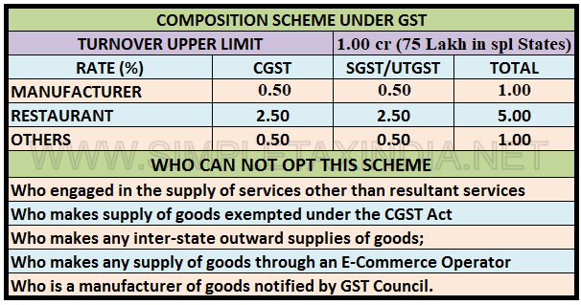
GST Composition Scheme

Slide 101
GST Composition Scheme
What are the advantages of Composition Scheme?
The following are the advantages of registering under composition scheme:
Lesser compliance (returns, maintaining books of record, issuance of invoices)
Limited tax liability
High liquidity as taxes are at a lower rate
What are the disadvantages of Composition Scheme?
Disadvantages of registering under GST composition scheme:
A limited territory of business. The dealer is barred from carrying out inter-state transactions
No Input Tax Credit available to composition dealers
The taxpayer will not be eligible to supply non-taxable goods under GST such as alcohol and goods through an e-commerce portal.

